Slide 1
ASTEX case
Gunilla Svensson
Department of Meteorology and the Bert Bolin Centre for Climate Research
Stockholm University, Sweden

Slide 2
Airmass tracked by ballons and forecasts – same airmass revisited with research aircraft

Slide 3
ASTEX 1st Lagrangian experiment
EUCLIPSE/GCSS Meeting, 29-30 September 2010
Svensson et al., 2000

Slide 4
ASTEX 1st Lagrangian experiment
EUCLIPSE/GCSS Meeting, 29-30 September 2010
Svensson et al., 2000

Slide 5
ASTEX 1st Lagrangian experiment
1-D version of the MIUU mesoscale model
Hydrostatic pressure
Prescribed background flow (geostrophic wind)
Surface fluxes (Fairall et al, surface layer similarity and roughness sub-layer treatment)
Second-order turbulence closure (Mellor-Yamada type with prognostic TKE)
Subgrid-scale condesation
Short and long-wave radiation (Fu&Liou, delta four-stream and correlated k-distribution)
A simplified algorithm for prognostic drizzle water
conversion of cloud water to drizzle
collection of cloud drops by raindrops
fall-out of rain drops
evaporation of rain drops in sub-saturated air
EUCLIPSE/GCSS Meeting, 29-30 September 2010
Svensson et al., 2000

Slide 6

A sub-grid scale cloud scheme in this framework:
Specific humidity
q_{s}
q´
(T, q)
*
T´
Temperature

Slide 7
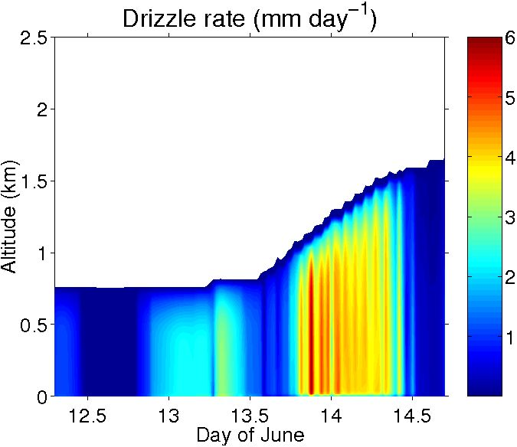
Model results

Slide 9
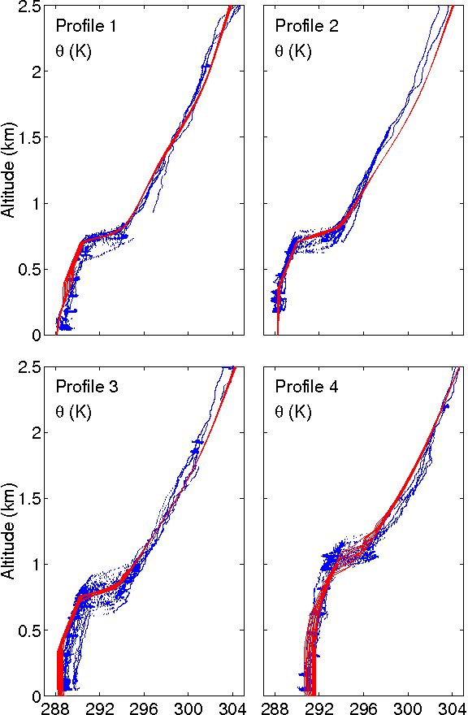
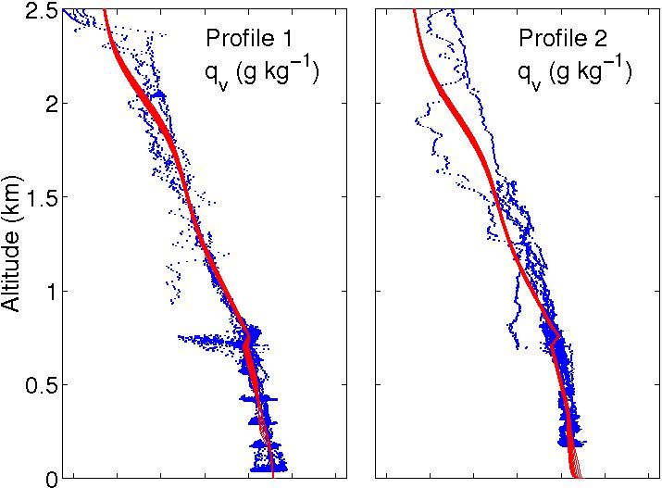
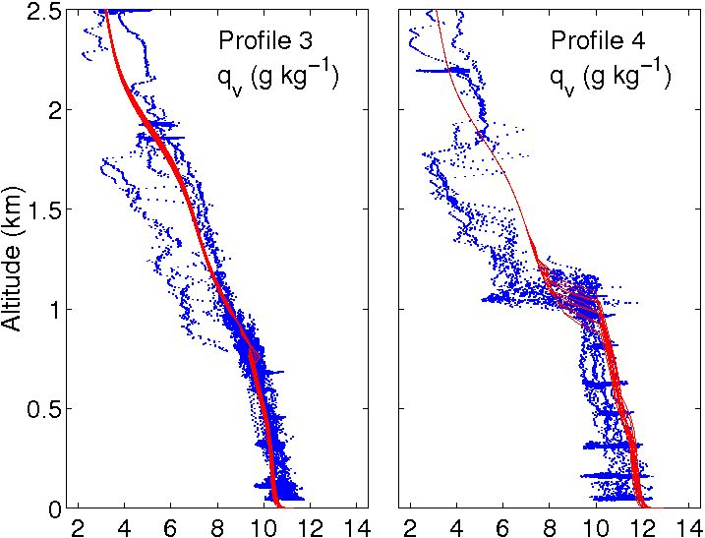

Slide 10
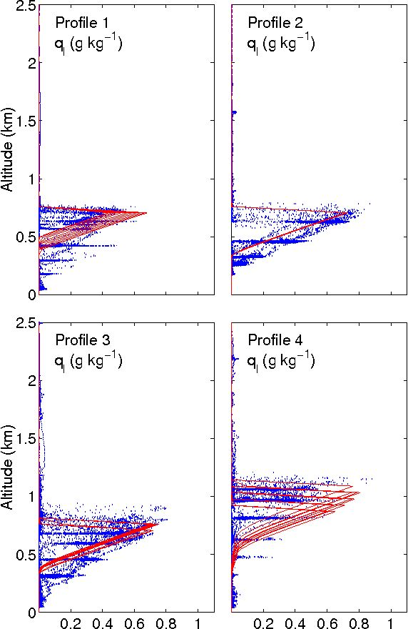

Slide 11
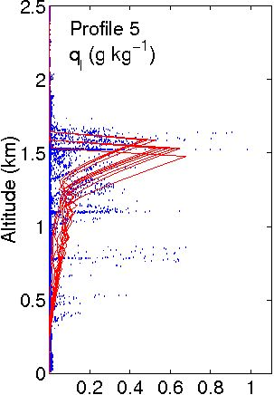

Slide 12
Latent heat flux and drizzle rate

Slide 13
Sensitivity experiments
SST or subsidence driving the change from Sc to Cu?
Drizzle only a few mm per day does it matter?
Subsidence very small vertical motions, is it important?
In a model it is possible to pick these pieces apart
–
never possible in real life

Slide 14
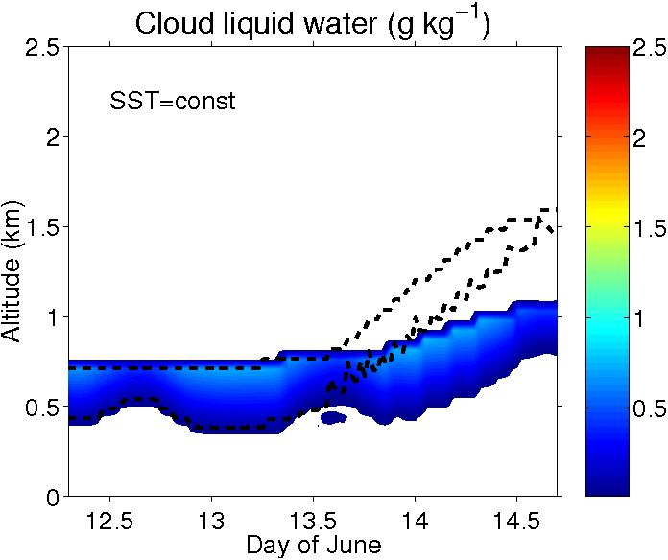
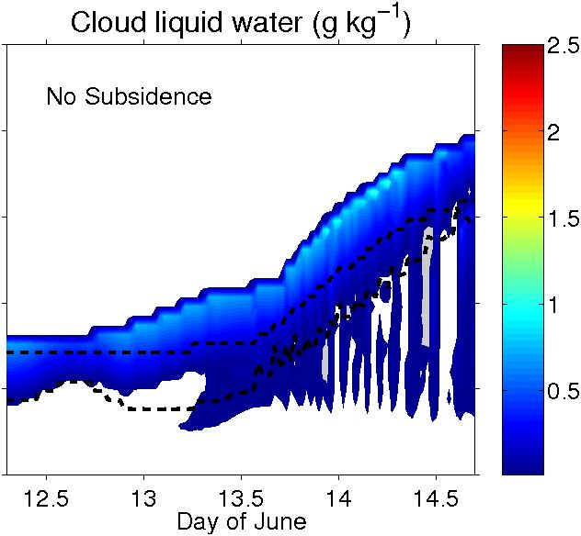
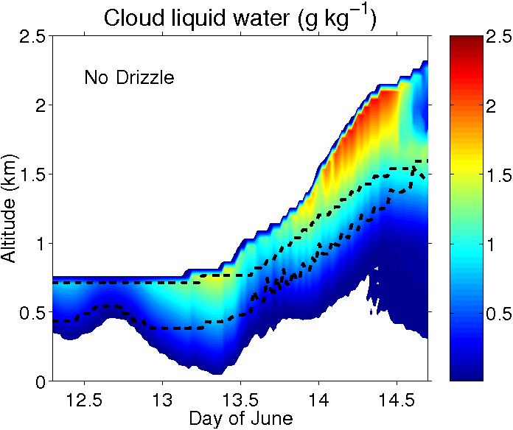

Slide 15
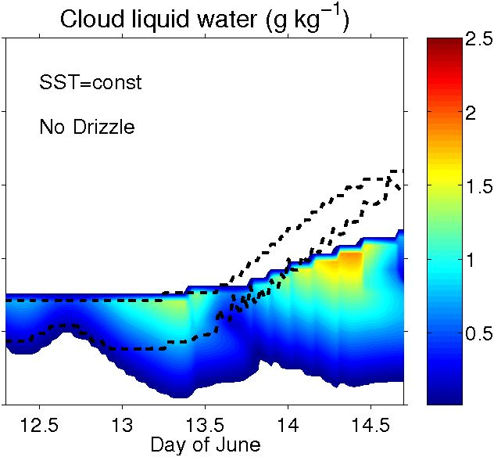
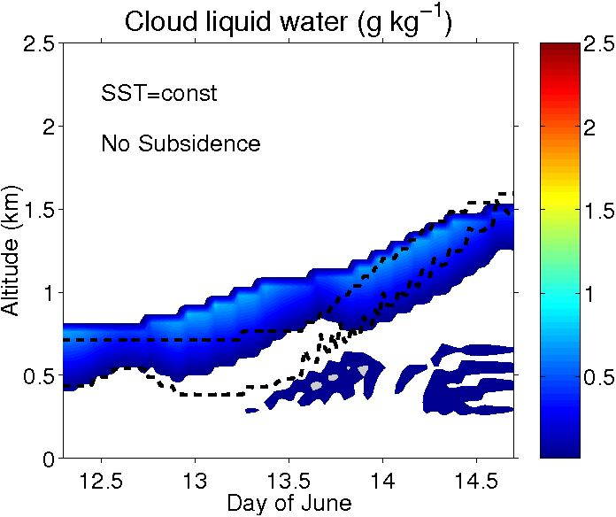
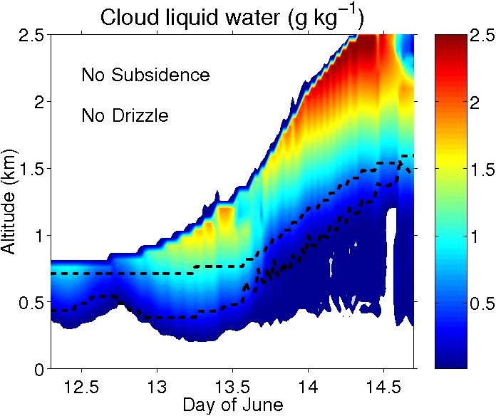
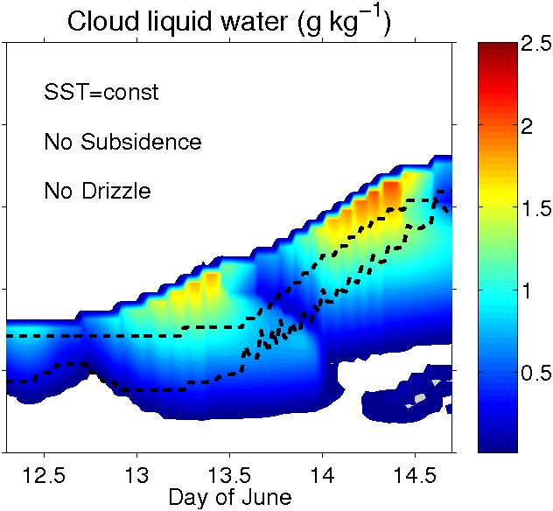

Slide 16
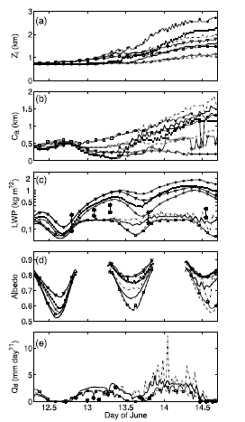
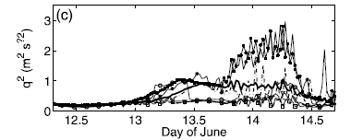
Sensitivity experiments
Z_{cloud-top}
Z_{cloud-base}
LWP
Albedo
TKE
Drizzle

Slide 17
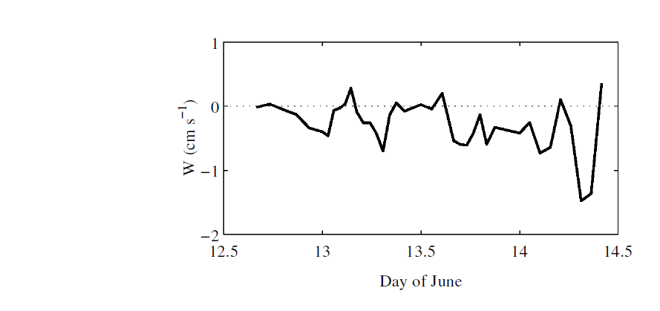
Vertical velocity at PBL top
HIRLAM simulation
Oscillations are due to inertia-gravity waves that propagate from the non-elliptic areas where gradient-wind balance cannot be maintained.
EUCLIPSE/GCSS Meeting, 29-30 September 2010
Sigg and Svensson, 2004

Slide 18
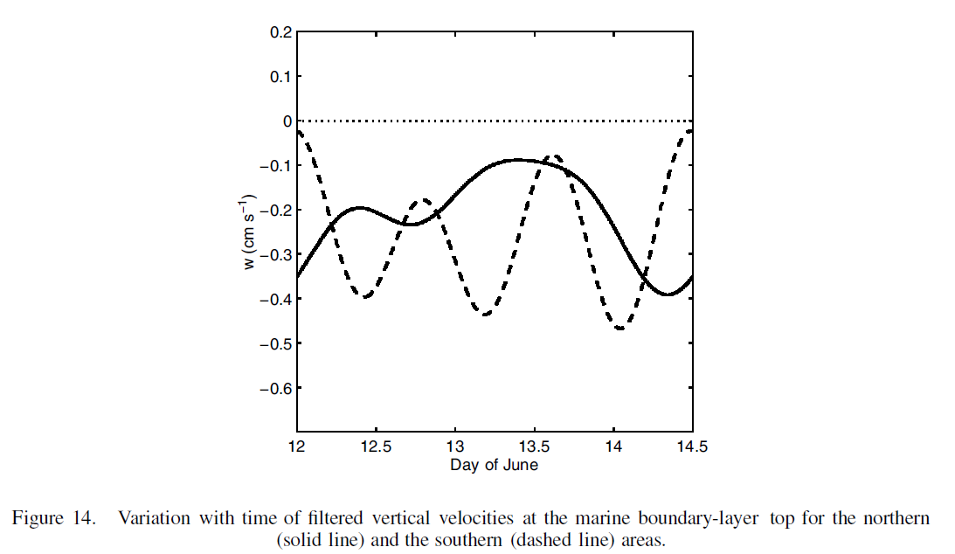
Synoptic-scale divergence
Filtered vertical velocities removing scales smaller than 15h
South
North
EUCLIPSE/GCSS Meeting, 29-30 September 2010
Sigg and Svensson, 2004

Slide 19
END

