Slide 1
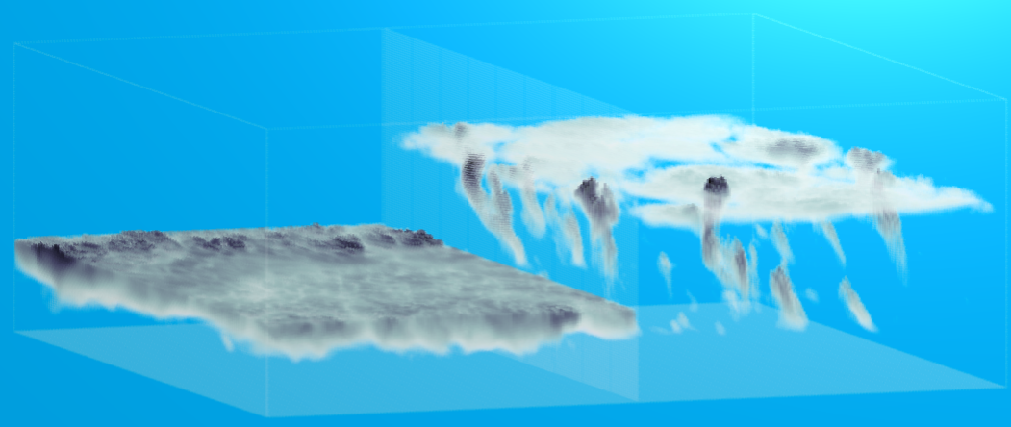
The ASTEX Lagrangian model intercomparison case
Stephan de Roode and Johan van der Dussen
TU Delft, Netherlands

Slide 2
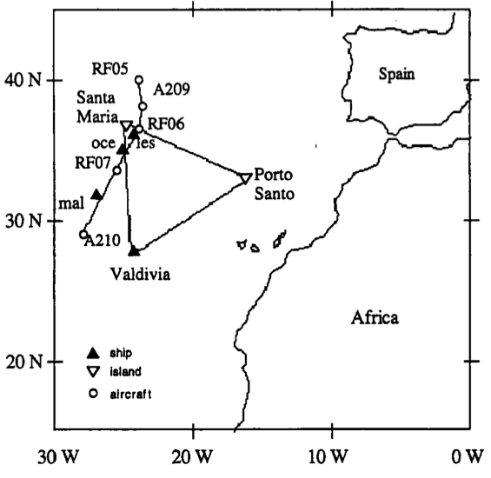
The ASTEX First Lagrangian (June 1992)
Flight 1
Flight 2
Flight 3
Flight 4
Flight 5
• Lagrangian evolution of cloudy boundary layer observed
• Five aircraft flights
• Duration: two days

Slide 3
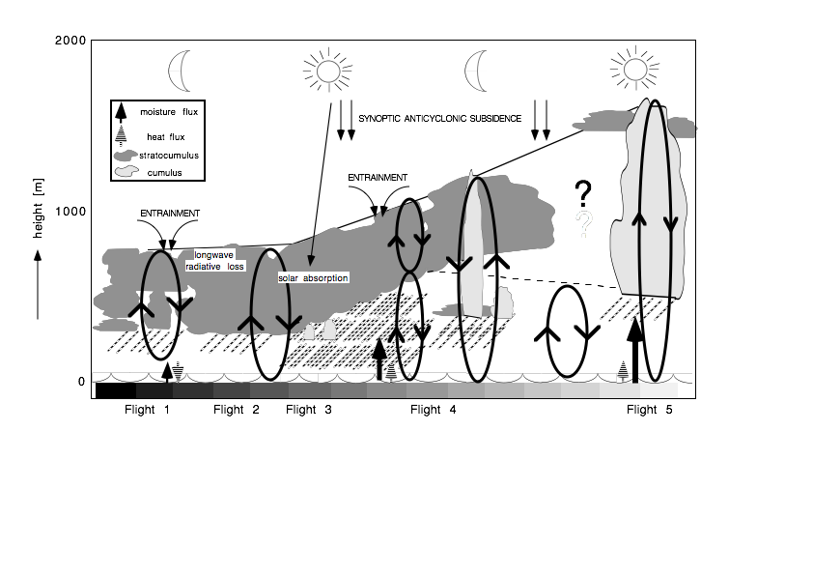
ASTEX observed stratocumulus to cumulus transition
Bretherton and Pincus, 1995
Bretherton et al, 1995
Duynkerke et al, 1995
De Roode and Duynkerke, 1997
GCSS case,
1995
EUCREM/GCSS,
Duynkerke et al, 1999
like GCSS ATEX case,
Stevens et al, 2001
Study of ASTEX First Lagrangian wtih SCM and 2D models by Bretherton et al, 1999:
"there are substantial quantitative differences in the cloud cover and liquid water path between models."

Slide 4
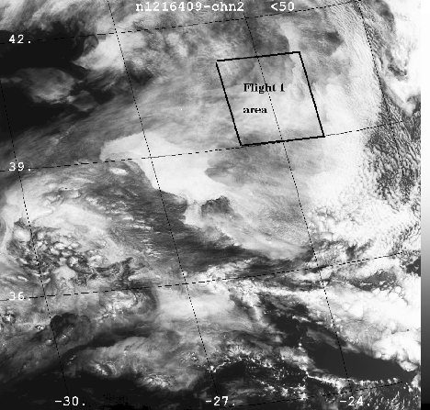
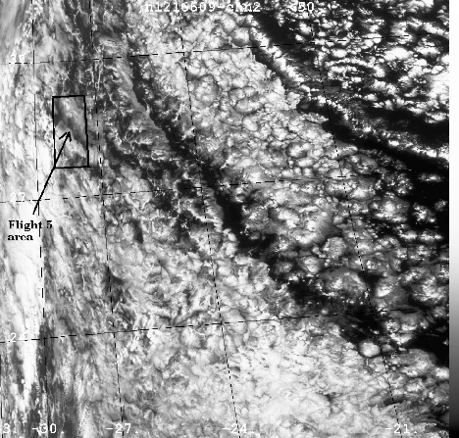
Satellite images Flights 1 and 5
latitude
longitude
precise position air mass during last flight uncertain

Slide 5
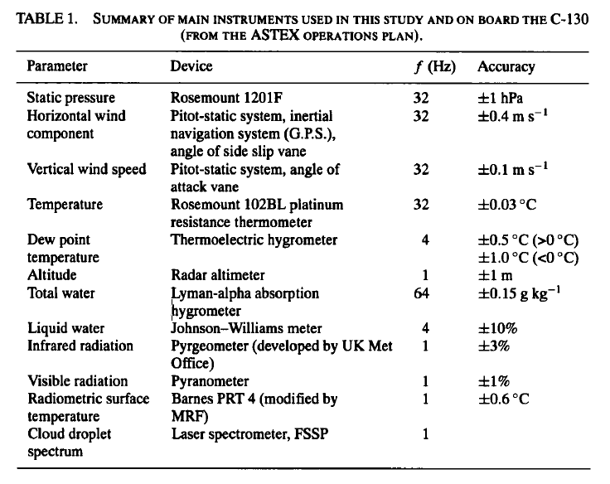
Observations

Slide 6
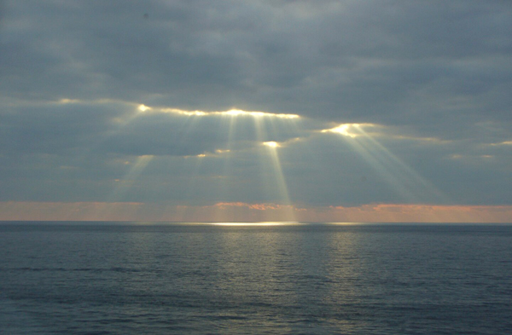
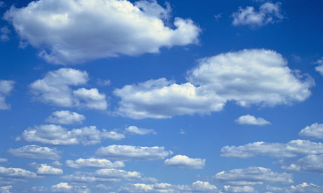
Contents
• Motivation
• LES results
• Cloud layer depth evolution analysis
• SCM results
• Conclusions/outlook

Slide 7
ASTEX case: motivation
• stratocumulus to cumulus transition controled by
- SST, large-scale divergence, inversion stability -> sensitivity tests
• Use ASTEX observations to validate LES & SCM results of a transition
• additional diagnostics from LES
-eddy diffusivity, PDFs of heat and moisture, mass flux statistics, 3D fields

Slide 8
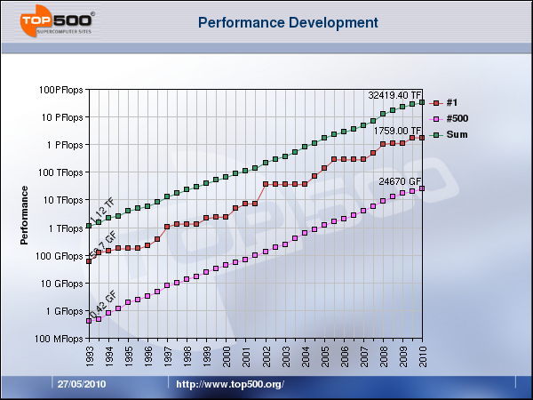
Motivation for a revised ASTEX case
GCSS ASTEX A209 case,
1995
EUCREM/GCSS,
Duynkerke et al, 1999
current LES:
• Detailed microphysics
• Multiband radiation
• Longer simulation time
Only 3~4 hours simulation time

Slide 9
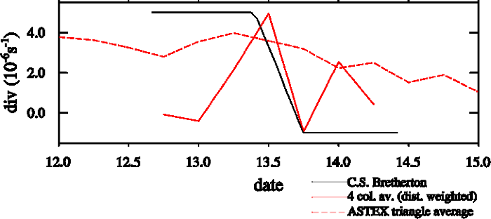
Model initialization
Model set up and large-scale forcing
• Large-scale forcing (SST & large-scale subsidence) from Bretherton et al. (1995, 1999)
• Model initialization from Flight 2 (A209)
- Identical to first GCSS ASTEX "A209" modeling intercomparison case
• Microphysics: drizzle and cloud droplet sedimentation
• Shortwave and longwave radiation
Bretherton ERA-40
mean in ASTEX triangle
ERA-Interim
ERA-Interim

Slide 10
LES participants
LES model | Institution | Investigator
DALES | TU Delft | de Roode
UCLA/MPI | MPI | Sandu
UKMO | UKMO | Lock
SAM | Univ Washington | Blossey
DHARMA | NASA | Ackerman
Warschau | Warschau | Kurowski

Slide 11
Use SCM version that is identical to the operational GCM
SCM model | Institution | Investigator
RACMO | KNMI | dal Gesso
EC-Earth | KNMI | dal Gesso
ECMWF | ECMWF | Sandu
ECMWF-MF | DWD | Koehler
JMA | Japan | Kawai
PDF based scheme | Wisconsin | Larson
LMD GCM | LMD | Bony
UKMO | UKMO | Lock
Arpege | Meteo France | Bazile/Beau
MPI | ECHAM | Suvarchal

Slide 12
Contents
• Motivation
• LES results
• Cloud layer depth evolution analysis
•SCM results
• Conclusions/outlook

Slide 13
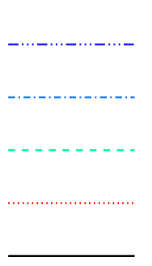
Cloud boundaries: all LES models give cumulus under stratocumulus
DHARMA
UKMO SAM
UCLA DALES
inversion height
DALES: large domain are shown
mean cloud base height
lowest cloud base height
Boundary layer too deep compared to observations
Last 10 hours of simulations are less reliable (sponge layer, coarser vertical resolution)

Slide 14
Cloud liquid water path
DHARMA
UKMO SAM
UCLA DALES
Large difference in LWP!

Slide 15
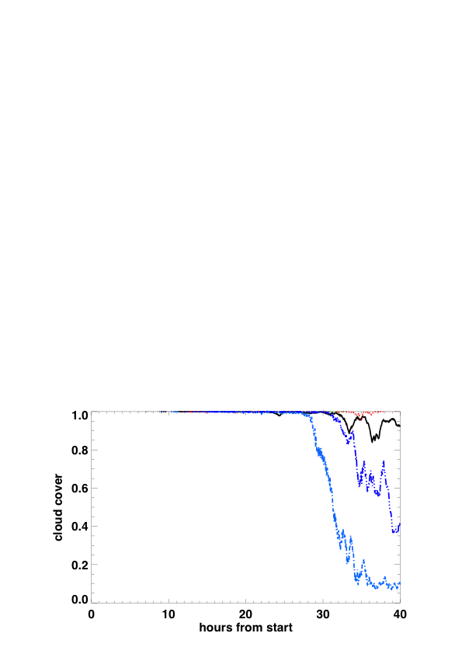
Cloud cover
DHARMA
UKMO SAM
UCLA DALES

Slide 16
Surface precipitation
180 W/m²
DHARMA
UKMO SAM
UCLA DALES
More heavy and intermittent precipitation on a larger domain

Slide 17
Entrainment rates in previous LES intercomparison runs
too large?
Heus et al. (2010)

Slide 18
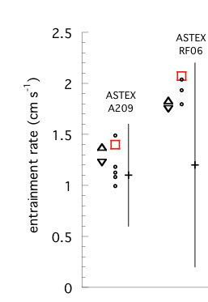
Entrainment
DHARMA
UKMO SAM
UCLA DALES
Entrainment rate doubles during the second night
Entrainment rate smaller than during previous ASTEX intercomparison case. According to Ackerman and Bretherton this is due to cloud droplet sedimentation leading to a reduction of evaporative cooling at cloud top.

Slide 19
Liquid water potential temperature
DHARMA
UKMO SAM
UCLA DALES
Slight differences in the upper part of domain:
- DALES & UCLA used ASTEX A209 specs with constant lapse rate
- ASTEX Lagrangian:blend of observations and ERA 40 (needed for radiation and single-column models)

Slide 20
Total water content
DHARMA
UKMO SAM
UCLA DALES
Mean state during first part of ASTEX Lagrangian is well represented

Slide 21
Liquid water content
DHARMA
UKMO SAM
UCLA DALES
last part of simulation: wrong cloud height

Slide 22
East-west wind component
DHARMA
UKMO SAM
UCLA DALES
Change in geostrophic forcing well implemented

Slide 23
North-south wind component
DHARMA
UKMO SAM
UCLA DALES
Do we need a larger weakening of the geostrophic forcing?

Slide 24
Vertical wind velocity variance
DHARMA
UKMO SAM
UCLA DALES

Slide 25
Horizontal wind velocity variance
DHARMA
UKMO SAM
UCLA DALES
More variance at a larger horizontal domain

Slide 26
Horizontal wind velocity variance
DHARMA
UKMO SAM
UCLA DALES
More variance at a larger horizontal domain

Slide 27
Total water variance
DHARMA
UKMO SAM
UCLA DALES
Larger horizontal domain can contain more variance

Slide 28
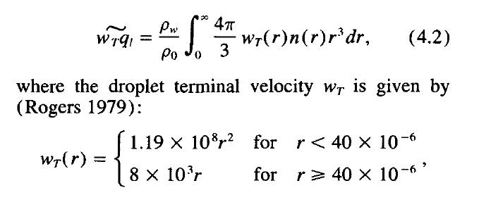
Precipitation
DHARMA
UKMO SAM
UCLA DALES

Slide 29
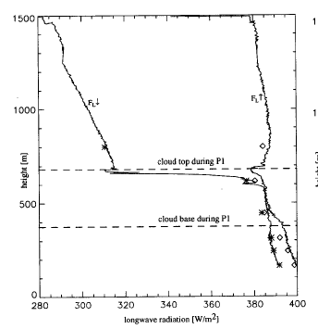
Jump in downward longwave rad smaller in observations

Slide 30
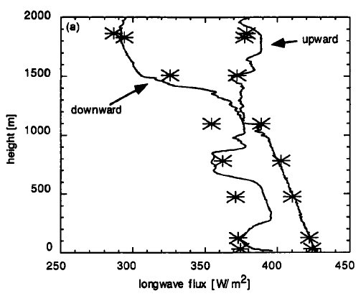
Longwave down
DHARMA
UKMO SAM
UCLA DALES
Obs t=36h
Presence of high clouds during latter part of transition.
A larger longwave radiative cooling rate will cause a larger entrainment rate and deeper boundary layers

Slide 31
Shortwave down
DHARMA
UKMO SAM
UCLA DALES
UCLA: Solar zenith angle
DALES: Error in radiation statistics of ASTEX version of the model

Slide 32
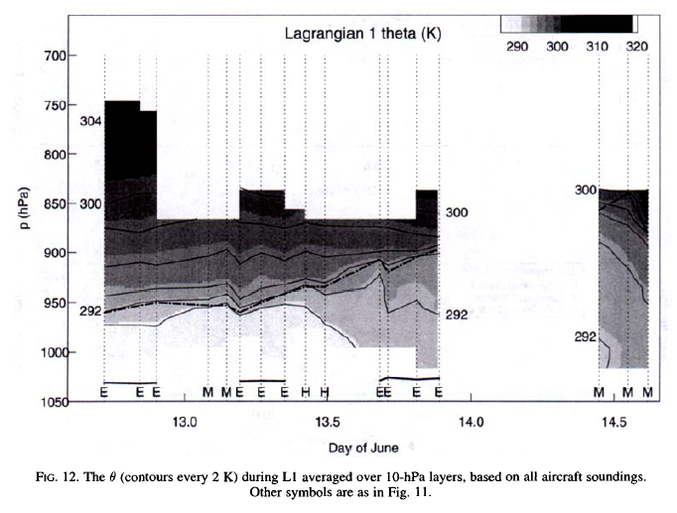
Estimate large-scale divergence from LES radiation in free atmosphere
Bretherton and Pincus (1995)
Estimated divergence = 2~3 10⁻⁶ s⁻¹ during Lagrangian

Slide 33
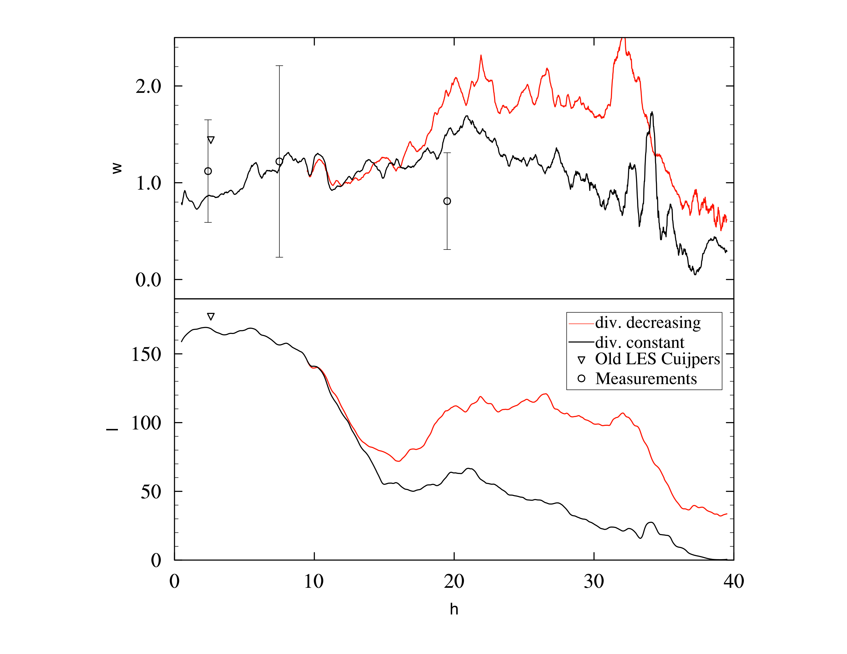
Large-scale divergence, entrainment (w_{e}) and liquid water path (LWP)
In constant divergence run
stratocumulus vanishes, and longwave radiative cooling at cloud top becomes very small
w_{e} (cm/s)
LWP (g/m²)

Slide 34
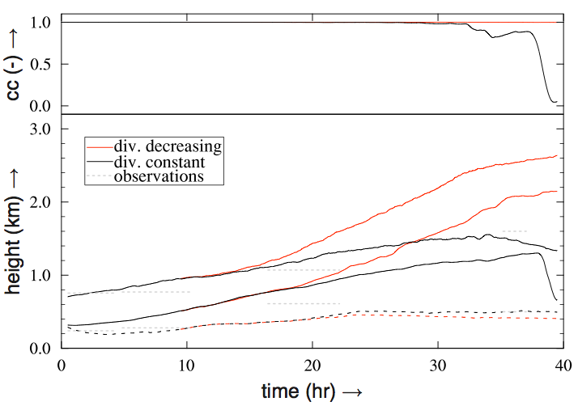
Cloud cover (cc) and cloud boundaries
average cloud top
average cloud base
lowest cloud base
• Divergence decreasing: deep solid stratocumulus
• Divergence constant: shallow cumulus

Slide 35
Contents
• Motivation
• LES results
• Cloud layer depth evolution
• SCM results
• Conclusions/outlook

Slide 36
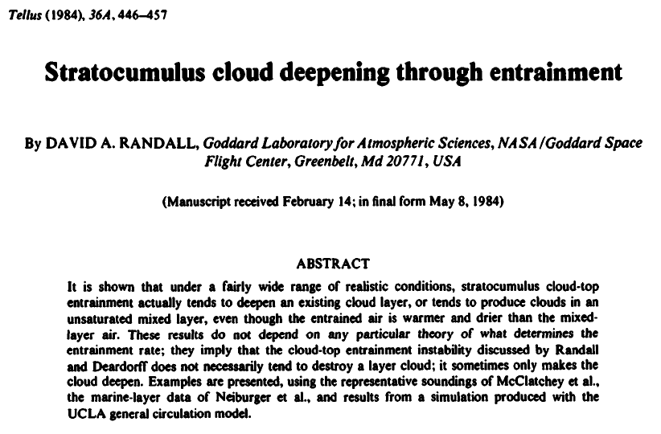

Slide 37
Cloud base height evolution
q_{sat}
q_{T}
z (m)
cloud base
(g/kg)

Slide 38
Cloud base height evolution
q_{sat}
q_{T}
z (m)
cloud base
(g/kg)

Slide 39
Cloud base height evolution
q_{sat}
q_{T}
z (m)
cloud base
(g/kg)

Slide 40
Tendencies in mixed layer
drizzle

Slide 41
Cloud base height evolution

Slide 42
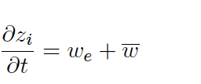
Cloud base and top height evolution
if rad cooling
Positive w ("upsidence") deepens cloud layer!

Slide 43
Cloud base and top height evolution
increase with time of:
- cloud top height
- cloud layer depth
ρc_{p}wθ_zbase= 11.3 W/m²
ρL_{v}wq_zbase = 60.0 W/m²
ΔLW= 74.0 W/m²
Div = 5.0 10⁻⁶ s⁻¹
zbase = 300 m, zi= 600 m
Δθ_{L} =5K, Δq_{T} = -1.1 g/kg

Slide 44
Example: Dycoms
ρc_{p}wθ_zbase= 11.3 W/m²
ρL_{v}wq_zbase = 60.0 W/m²
ΔLW= 74.0 W/m²
Div = 5.0 10⁻⁶ s⁻¹
zbase = 500 m, zi= 800 m
Δθ_{L} =12K, Δq_{T} = -9.1 g/kg

Slide 45
Contents
• Motivation
• LES results
• Cloud layer depth evolution
• SCM results
• Conclusions/outlook

Slide 46
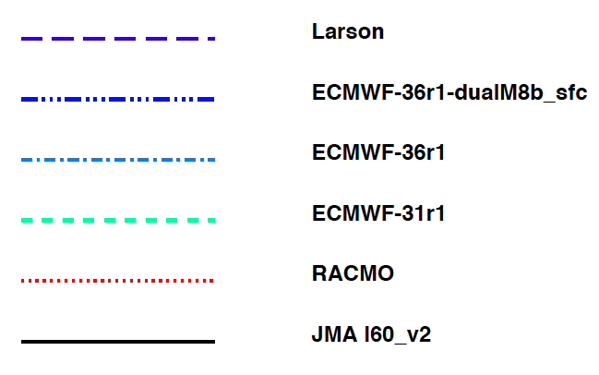
SCM cloud boundaries
Deepening of boundary layer is well represented

Slide 47
SCM LWP
Liquid water path variation is large

Slide 48
SCM total cloud cover

Slide 49
SCM surface precipitation
Similar diffusivities for moisture and heat?

Slide 50
East-west wind velocity

Slide 51
East-west wind velocity

Slide 52
Liquid water potential temperature

Slide 53
Liquid water content

Slide 54
SCM cloud fraction

Slide 55
Eddy diffusivity
LES results EUROCS FIRE stratocumulus
Do SCMs use similar diffusivities for moisture and heat?

Slide 56
What did we learn
LES models can reproduce bulk features of the observed cloud transition
- mean state and turbulence structure
Entrainment rate smaller than in previous ASTEX intercomparison cases
Negative divergence halfway the transition causes deeper cloud layers (found from sensitivity tests).

Slide 57
Problems and possible case refinements
Too deep boundary layer
1. change divergence
2. downwelling longwave radiation: check moisture content in free atmosphere
- time varying upper atmosphere?
3. presence of high clouds during the last part of the Lagrangian
4. domain size
Reduce geostrophic forcing even further?
All models need to use same initial profiles

Slide 58
Outlook/suggestions
LES output
3D fields
Radiation
All modelers should provide a "fingerprint" of their radiative tranfer code by running their codes for one step using a few different thermodynamic profiles and for different solar zenith angles

